Slide 1
Natural Gas Consumption − Seasonaly Adjusted
in USA (1973 − July, 2023)
2500
Billion Cubic Feet
2000
1500
1980 Jan
1990 Jan
2000 Jan
2010 Jan
2020 Jan
Month

Slide 2
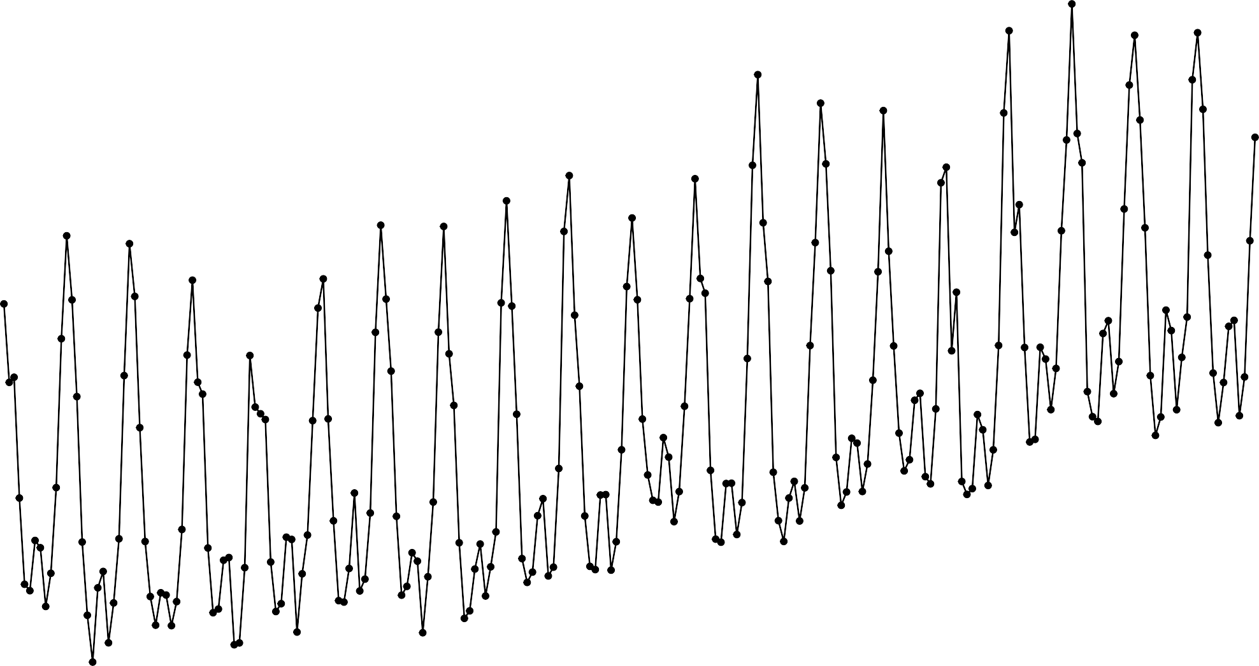
Time−Series of Natural Gas Consumption
in USA (2002−2021)
3500
3000
Billion Cubic Feet
2500
2000
1500
2005 Jan
2010 Jan
2015 Jan
2020 Jan
Month

Slide 3
US Natural Gas − Export Market
Time Series of Exports (Qty) and Henry Hub Price Index (1997−2022)
10
10
Exports (10 Billion Cubic Feet)
Price ($ per Million Btu
Price
5
5
Exports
0
0
2000 Jan
2005 Jan
2010 Jan
Month
2015 Jan
2020 Jan

Slide 4
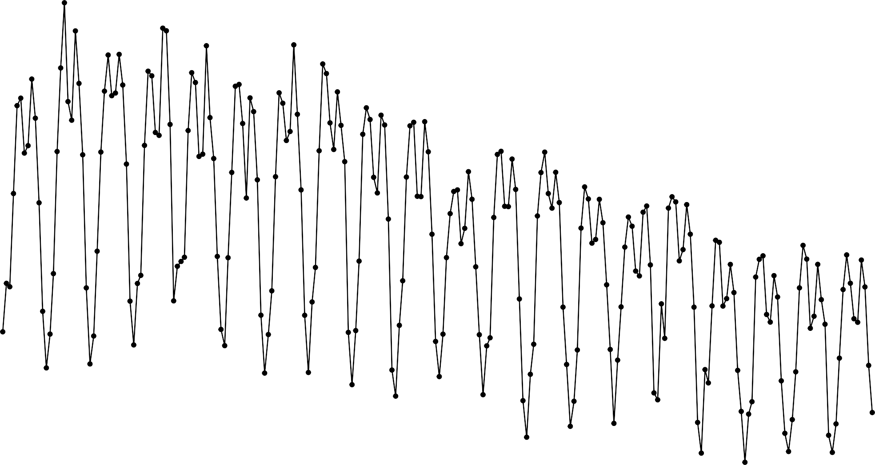
Time−Series of Natural Gas Consumption (Transformed)
in USA (2002−2021)
0.009
Transformed Cubic Feet
0.008
0.007
0.006
2005 Jan
2010 Jan
2015 Jan
2020 Jan
Month

Slide 5
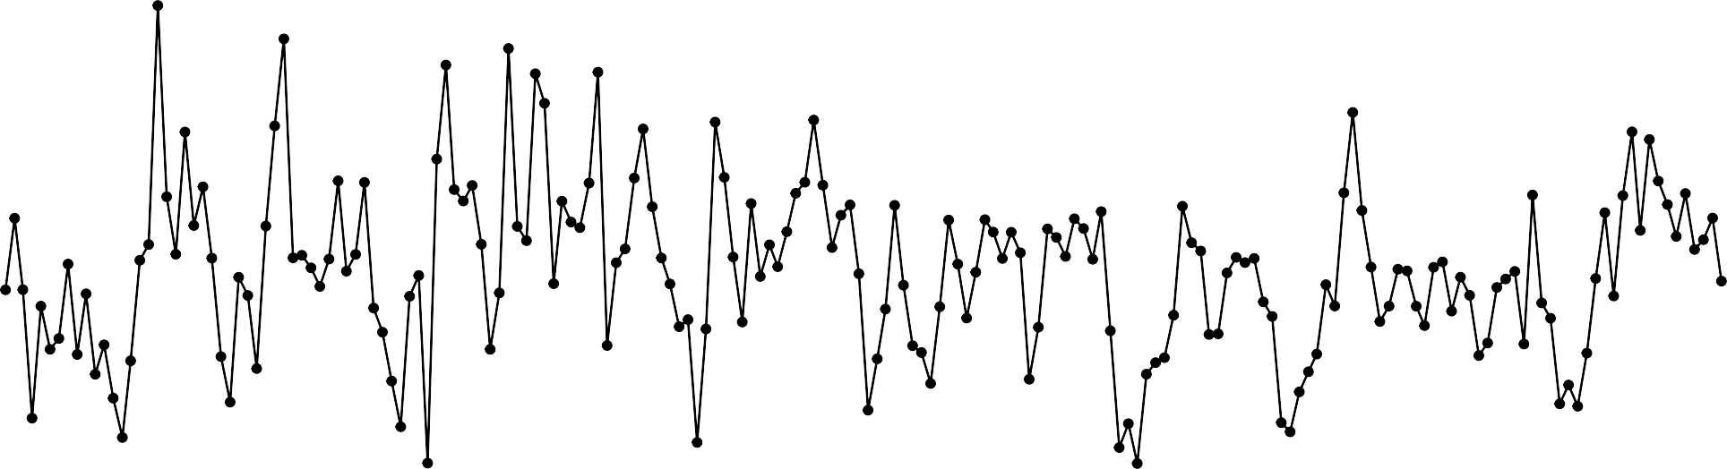
0.00050
Innovation residuals
0.00025
0.00000
−0.00025
2005 Jan
2010 Jan
YearMonth
2015 Jan
0.4
40
30
acf
0.2
count
20
0.0
10
0
6
12
18
−0.00050
−0.00025
0.00000
0.00025
0.00050
lag [1M]
.resid

Slide 6
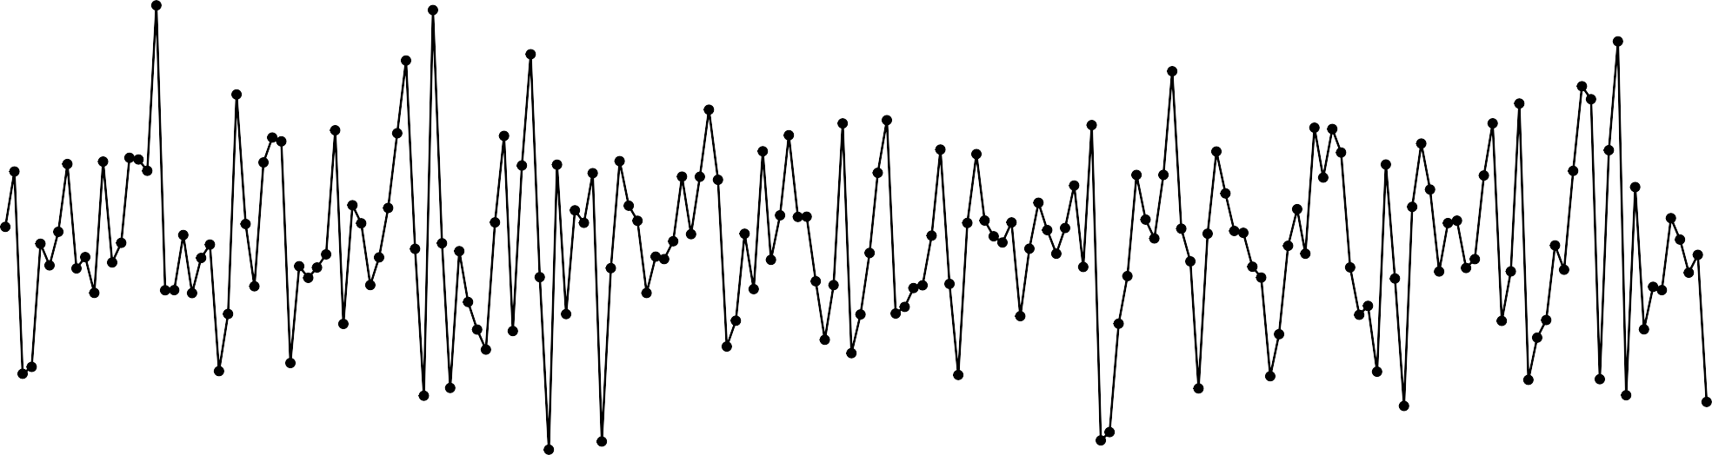
Innovation residuals
0.04
0.00
−0.04
2005 Jan
2010 Jan
YearMonth
2015 Jan
0.2
40
0.1
30
acf
count
0.0
20
−0.1
10
−0.2
0
6
12
18
−0.04
0.00
0.04
0.08
lag [1M]
.resid

Slide 7
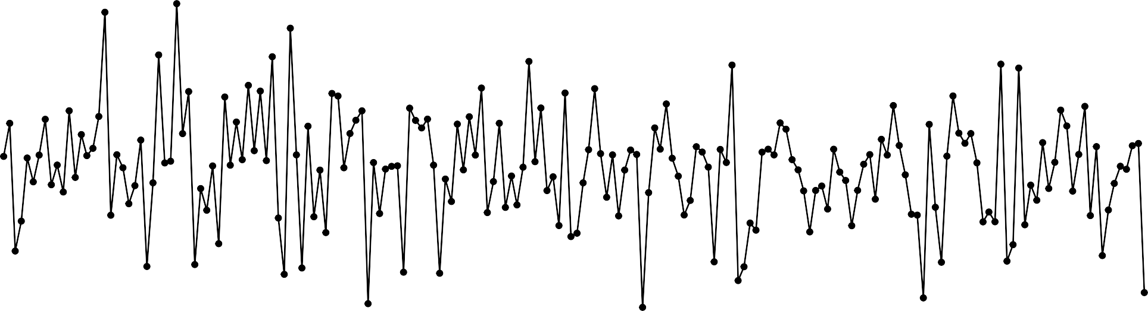
0.00050
Innovation residuals
0.00025
0.00000
−0.00025
−0.00050
2005 Jan
2010 Jan
YearMonth
2015 Jan
0.2
0.1
40
acf
count
0.0
20
−0.1
−0.2
0
6
12
lag [1M]
18
−0.0003
0.0000
.resid
0.0003

Slide 8
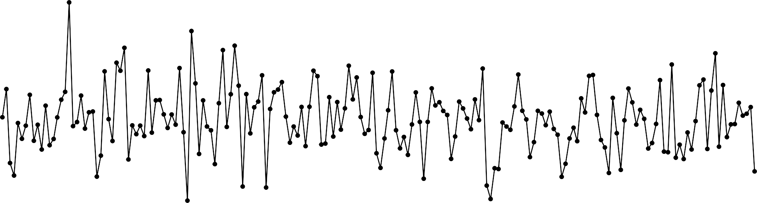
0.0004
0.0002
0.0000
−0.0002
−0.0004
Innovation residuals
2005 Jan
2010 Jan
YearMonth
2015 Jan
40
0.2
30
0.1
acf
count
20
0.0
10
−0.1
0
6
12
lag [1M]
18
−0.00025
0.00000
.resid
0.00025
0.00050

Slide 9
Regression Model Forecast
Transformed Natural Gas Consumption
0.008
level
80
95
0.006
0.004
2005 Jan
2010 Jan
2015 Jan
2020 Jan
Month

Slide 10
ETS Model Forecast
0.009
Transformed Natural Gas Consumption
0.008
level
0.007
80
95
0.006
0.005
2005 Jan
2010 Jan
2015 Jan
2020 Jan
Month

Slide 11
ARIMA Model Forecast
0.009
Transformed Natural Gas Consumption
0.008
level
80
95
0.007
0.006
0.005
2005 Jan
2010 Jan
2015 Jan
2020 Jan
Month

Slide 12
Aggregate Model Forecast
0.009
Transformed Natural Gas Consumption
0.008
level
0.007
80
95
0.006
0.005
2005 Jan
2010 Jan
2015 Jan
2020 Jan
Month

